Slide 1
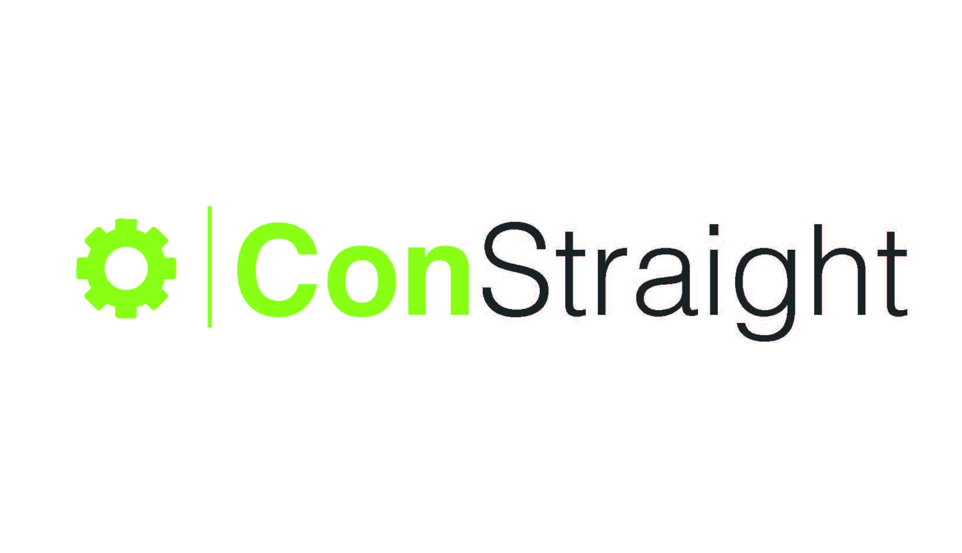



Azure Local – Was bringt mir das SDN Setup?
Ulas Meric IT-Architect & BDM
Markus Klein Managing Technical Director

Slide 2

Wer sind wir?
Die Experten für Microsoft Cloud Technologie
Gegründet 2023 mit „OpenBook Consulting Fokus“ für den Mittelstand und Großkunden
Hybride Architekturen, Anbindungs-szenarien und Business Continuity sind unsere Fokus-Themen
Über unser Expertennetzwerk, unsere Unternehmensgruppe und unsere eigenen Mitarbeiter liefern wir Professionalität und hervorragende Expertise in unseren Projekten

Slide 3






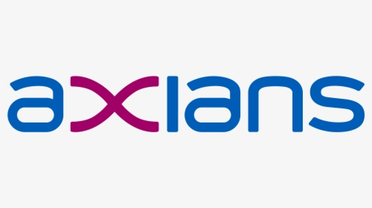

Unsere Kunden (Auszug)

Slide 4

And now it’s going to be technical ….

Slide 5
Azure Local – Netzwerk today
Only vNets & subnets available
No Firewalls/ Gateways/NSGs
No Software Load Balancing

Slide 6

What is SDN?
Provides a way to centrally configure and manage networks and network services
Dynamically create, secure and connect your network
Virtual network elements such as Hyper-V Virtual Switch, Hyper-V Network Virtualization and Software Load Balancer are integral elements
Three major components make up the Windows SDN fabric:
Network Controller
Software Load Balancer
Gateways
Notes:
Software defined networking (SDN) provides a way to centrally configure and manage networks and network services such as switching, routing, and load balancing in your data center. You can use SDN to dynamically create, secure, and connect your network to meet the evolving needs of your apps. Operating global-scale datacenter networks for services like Microsoft Azure, which efficiently performs tens of thousands of network changes every day, is possible only because of SDN.
Virtual network elements such as Hyper-V Virtual Switch, Hyper-V Network Virtualization, Software Load Balancing, and RAS Gateway are designed to be integral elements of your SDN infrastructure. You can also use your existing SDN-compatible devices to achieve deeper integration between your workloads running in virtual networks and the physical network.
There are three major SDN components, and you can choose which you want to deploy: Network Controller, Software Load Balancer, and Gateway.

Slide 7

SDN in Azure Stack Local
SDN in Azure Stack HCI helps address challenges associated with traditional network infrastructures by increasing agility, improving security, and optimizing efficiency.
It provides the following capabilities:
Abstracting network services
Centralizing network policies
Centralizing network management
Notes:
SDN in Azure Stack HCI helps address challenges associated with traditional network infrastructures by increasing agility, improving security, and optimizing efficiency. It provides the following capabilities:
Abstracting network services. You can deploy and manage software-defined network services, abstracted from the underlying physical network.
Centralizing network policies. You can use network policies to centrally configure and control rules that govern traffic flow within and between virtual and physical networks. Implementing network policies enhances consistency and scalability as the volume of network services increases.
Centralizing network management. You can manage the virtualized network infrastructure by using PowerShell, Windows Admin Center, and Microsoft System Center Virtual Machine Manager (VMM).
These capabilities of Azure Stack HCI SDN are implemented by using Network Controller. Network Controller is a server role that provides a management interface that’s accessible via the Representational State Transfer (REST) Application Programming Interface (API). The interface is used for the deployment, management, configuration, monitoring, and troubleshooting of SDN infrastructure and network function virtualization-based services.

Slide 8
Azure Local Network Controller

Slide 9
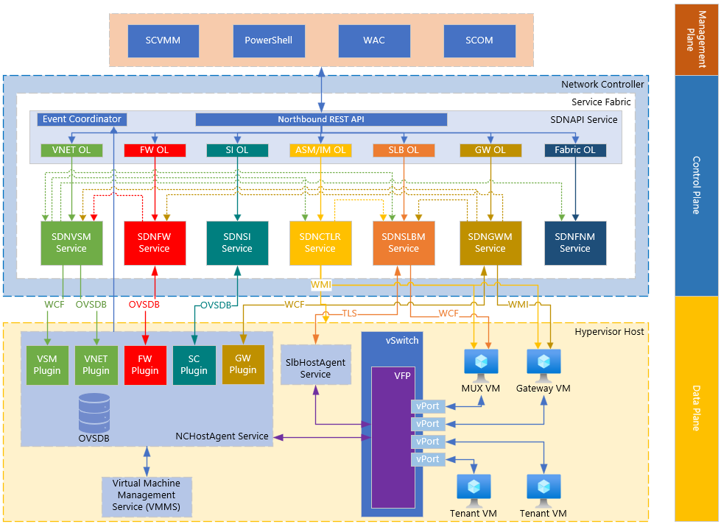
Network Controller high-level architecture
Notes:
This provides an overview of the Network Controller architecture at a high level. This module will explore the different components that make up the Network Controller architecture, with further expansion of certain topics into more focused modules.

Slide 10
Architecture overview
Highly available and scalable server role
Separates functionality into service modules (microservices)
Relies on Windows Service Fabric for high availability
Northbound API (REST interface)
Provides you with the ability to gather network information from network controller and use it to monitor and configure the network.
Configure, monitor, troubleshoot and deploy new devices on the network by using Windows PowerShell, REST, System Center Virtual Machine Manager (SCVMM), Windows Admin Center (WAC), and more.
Uses a JSON data model to represent resources.
Supports CRUD operations on resources through NB API.
Southbound API
Network controller can discover network devices, detect service configurations, and gather all the information you need about the network.
Provides pathway to send information to the network infrastructure, such as configuration changes that you have made.
Management applications
Network-aware applications
Network controller
Virtual network infrastructure
Physical network infrastructure
NIC
Notes:
Network Controller is a highly available and scalable server role and provides one application programming interface (API) that allows Network Controller to communicate with the network, and a second API that allows you to communicate with Network Controller.
You can deploy Network Controller in both domain and non-domain environments. In domain environments, Network Controller authenticates users and network devices by using Kerberos; in non-domain environments, you must deploy certificates for authentication.
Network Controller communicates with network devices, services, and components by using the Southbound API. With the Southbound API, Network Controller can discover network devices, detect service configurations, and gather all of the information you need about the network. In addition, the Southbound API gives Network Controller a pathway to send information to the network infrastructure, such as configuration changes that you have made.
The Network Controller Northbound API provides you with the ability to gather network information from Network Controller and use it to monitor and configure the network.
The Network Controller Northbound API allows you to configure, monitor, troubleshoot, and deploy new devices on the network by using Windows PowerShell, the Representational State Transfer (REST) API, or a management application with a graphical user interface, such as Azure Stack.

Slide 11

Azure Networks

Slide 12
Virtual network service
The virtual network (vNet) service operates as a stateful service within Network Controller.
Controls the virtual networks and exposes capabilities to the management plane.
Runs parallel to virtual switch management service under the SDNVSM parent service.
Leverages the OVSDB protocol to push configuration to the MS_VTEP database.
Responsible for:
Tenant Customer Addresses (CA) and virtual network management.
Port CA to PA mappings management.
Route management for gateways, User Defined Routes (UDR), and ILB
Notes:
vSwitch is a stateful service module that is part of our Network Controller architecture. Virtual Network Manager within the vSwitch controls Virtual Networks and expose capabilities of our virtual networking solution to the management plane. It communicates and interacts with other Network Controller services to manage the dataplane routing.
vSwitch services performs some very important functionality, specifically:
Tenant CA & VNET management
Port CA PA Mappings management
Route management for gateways, UDR, ILB etc

Slide 13
Virtual switch management service
Virtual Switch Management performs all vSwitch operations and functionality.
Computes policies and pushes down to the Host Agent.
Runs parallel to the Vnet Service under the SDNVSM parent service.
Leverages WCF to push policies down to the host.
Performs the following:
QoS and SR-IoV settings for port and switch.
DNS and DHCP management for tenant ports.
Port security settings like MacSpoofing, ArpGuard, and DhcpGuard
Connectivity checks (CA PING).
Host PA address management.
Notes:
Virtual Switch Management is another service parallel to the VNET service. Both VNET and VSM reside in the parent container process by the name of SDNVSM.exe.
The VSM service performs all the vSwitch operations and functionality. It computes the policies and pushes them down to Hostagent which builds the corresponding VFP layers for carrying out all packet processing operations. VSM was originally intended to be with VNET service but due to limitations in the OVSDB protocol, a call was made to switch to WCF for pushing certain policies down to the host.
The following slide shows the policies processed by VNET and VSM service:
VSM:
QoS & IoV Settings for port & switch
DNS & DHCP management for tenant ports
Port Security settings like MacSpoofing, ArpGuard, DhcpGuard, StormLimit etc
Port Isolation Settings
Connectivity Checks (CA PING)
Host PA address management

Slide 14
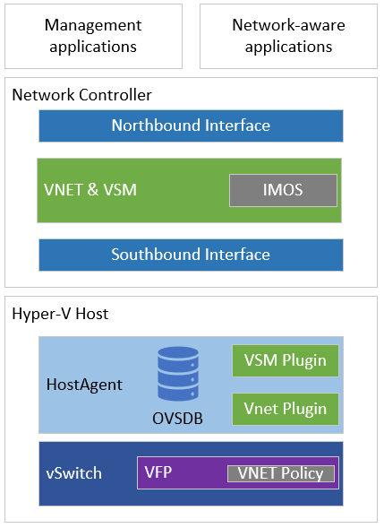
Architecture overview
Virtual network and virtual switch architecture is comprised of the following resources:
Northbound API
VNET service module
VSM service module
NC Host Agent
OVSDB
VSM Plugin
VNET Plugin
Virtual Filtering Platform (VFP)

Slide 15
Datacenter Firewalls

Slide 16

Important
In Windows Admin Center 2208+ builds, Access Control Lists (ACLs) have been renamed to Network Security Groups (NSGs) to align with Azure and Azure Stack.
ACLs and NSGs can be used interchangeably as of this content writing as NSGs will be the public facing resource. ACLs will still be used internally as part of a control / data plane configuration.

Slide 17
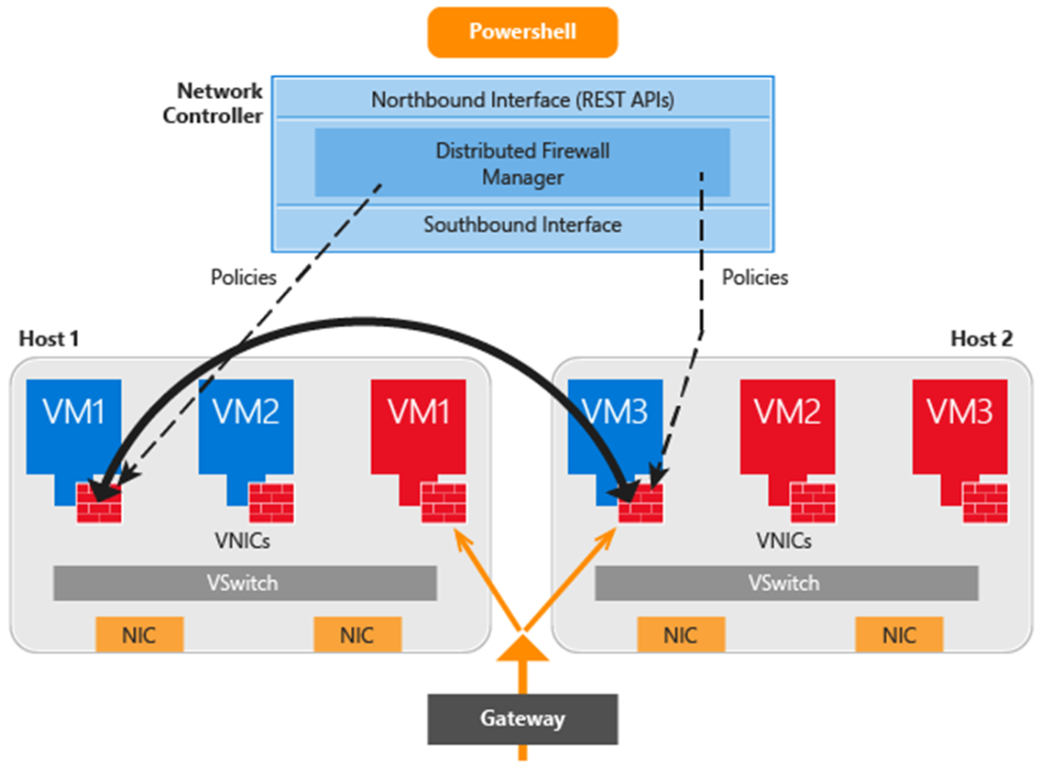
Datacenter firewall overview
5-tuple stateful, multi-tenant firewall.
Protocol
Source IP address
Source port number
Destination IP address
Destination port number
Protects east-west and north-south traffic flows.
Firewall policies are enforced at the virtual switch port of each tenant VM.

Slide 18
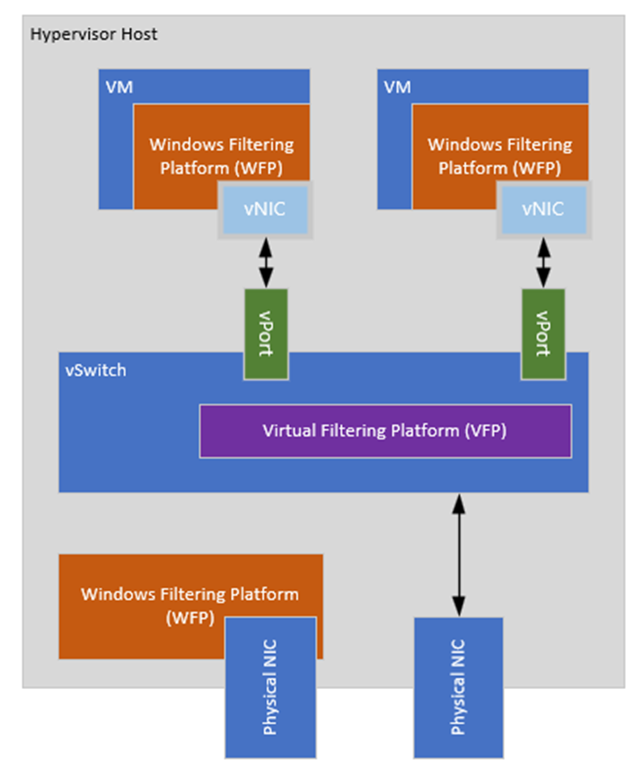
Why datacenter firewall?
Traffic routing through the virtual switch isn’t processed by Windows Filtering Platform (WFP) on the host.
Datacenter Firewall enables cloud operators to ensure tenants are adhering to certain security standards.
Notes:
Windows Firewall Policy (WFP), however traffic going through a virtual switch is not processed by WFP.
WFP within the Guest OS is processed as normal.
As an operator or administrator, ensure that guests are adhering to good policies as they may not know which Windows Firewall policies are configured within the Guest OS.

Slide 19
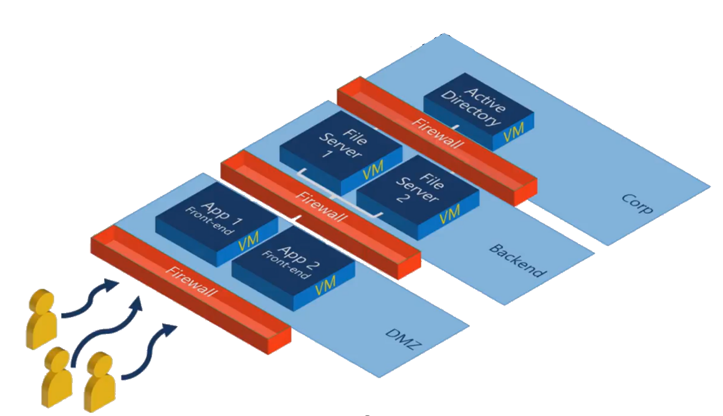
Traditional security boundaries
Firewall devices are implemented into network architecture to create zones or boundaries.
Requires overhead to maintain and modify policies that may require unique/independent configuration per device.
Notes:
Traditionally, security boundaries look like the diagram above where “zones” or “boundaries” are created, and firewall appliance is put between each boundary to provide security. This security boundary model doesn’t offer the best protection and can require a lot of administration.

Slide 20
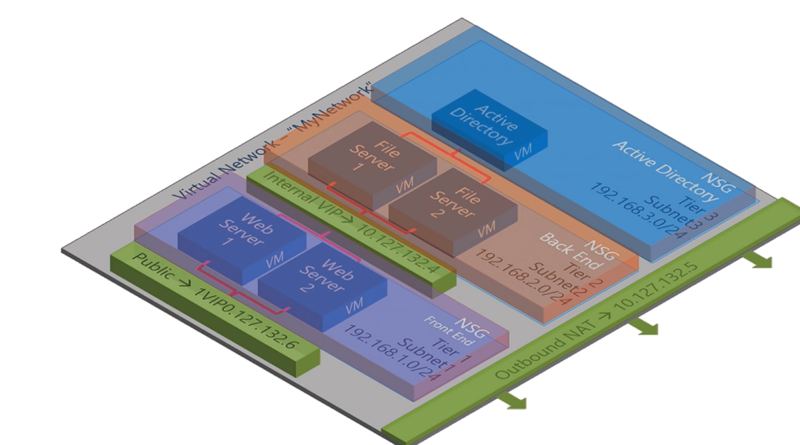
SDN security boundaries
NSGs can apply security policy across all VMs within a subnet.
Each subnet can have its own ACL and is inherited automatically for new deployments.
Traffic between subnets can be allowed or blocked based on 5-tuple rules.
VMs and virtual networks can have a public virtual IP attached to allow outbound/inbound communications.
Notes:
By utilising Access Control Lists (ACLs) we can apply security policy across the subnet which will automatically apply to all new virtual machines added into the Tier
In this diagram, a single Virtual Network has been deployed, with multiple subnets where virtual machines are deployed to. Each of the subnets have their own Network Security Group (NSG) which the network interfaces for the associated VMs will automatically inherit upon provisioning. Traffic between the subnets by default are allowed, however further restrictions can be made to only expose certain endpoints within the subnet.
Network Interfaces within the Virtual Network, will have an outbound NAT to enable outbound external connectivity. No traffic is allowed from external from the Virtual Network to the File Server and AD subnets. Web Server 1 and 2, have their own outbound NAT (Public VIP) attached to enable incoming/outgoing.

Slide 21
Software Load Balancers

Slide 22
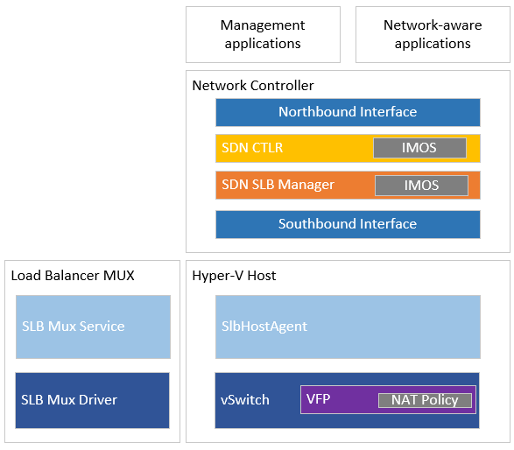
Architecture overview
SLB architecture is composed of the following resources:
SDN Controller Service.
SLB Manager Service.
Load Balancer Mux.
SLB Host Agent.
Virtual Filtering Platform (VFP).

Slide 23
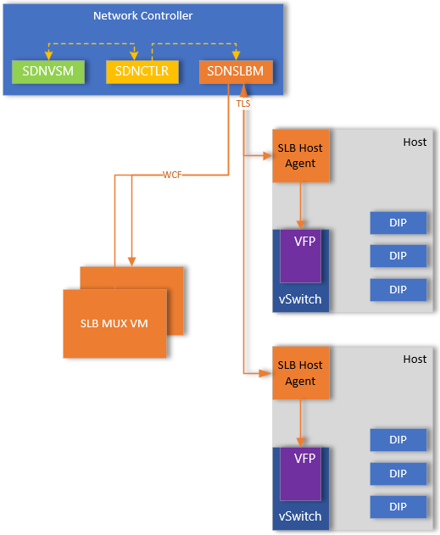
Policy configuration
Like other NC services, SDN Software Load Balancer Manager (SDNSLBM) will receive REST operations via Northbound API.
SDN API sends load balancer object to SDN Controller service.
SDN Controller sends the configuration to SLB Manager Service.
Policies are pushed from SLB Manager Service via Southbound API to SLB MUX Service and SLB Host Agent.
SLB Mux Service will program the policies in SLB MUX Driver on MUX VM.
SLB Host Agent will program policies into VFP switch extension.
Policies are configured with the MUXes as well as SLBHostAgent.
SLBHostAgent will monitor DIP endpoints and communicate to SLB Manager service if DIP is offline.
Notes:
SdnCtlr service has a component called NetworkManager (NM) that's also a part of SLB control plane. It has a KVS data store as well as an IMOS data store. Whenever we add/update/delete a LoadBalancer, SDN API calls WCF API of SdnCtlr and passes the LB object. The goal state driver sends it down to SLB Manager Service.
SLB Manager is responsible for configuration of the VIP:DIP mappings on the MUXes and Hypervisor hosts. This allows enables both inbound and outbound packet flows to leverage the VIP:DIP mappings. In addition to configuring the VFP, SLB Host Agent will monitor the DIP endpoints for any configured VIPs. In scenarios where the DIP is offline/inaccessible, SLB Host Agent will communicate this to SLB Manager Service, which in turn will push new policy configuration to reflect the DIP is not available.
SLB Manager / SLB Host Agent do not monitor for fabric notifications as it’s not their responsibility. Instead VNET service is responsible for computing the where the PA:CA mappings resides based on where the VM is placed on fabric, and will notify SLB Manager, which enables SLB Manager to update its policies. In scenarios where VM and its corresponding DIP are live migrated to new host, VSM service will be notified via Event Coordinator and will make necessary routing adjustments for virtual network, in addition to informing SLB Manager of the new PA – CA mappings.

Slide 24
SDN controller service
Receives data from the SDN API service.
Responsible for create and update operations for load balancer resources.
Communicates with vSwitch Service (VNET Manager) as well to get IP configuration details.
Once the goal state is configured, passes information to SLB Manager service for further processing.

Slide 25
SLB manager service
Receives instructions via WCF from the SDN Controller service.
Calculates Virtual IP (VIP) and Direct IP (DIP) address mappings.
Works with SLB southbound drivers responsible for southbound policy configuration to SLBHostAgent and SLBMux Service.
Leverages a combination of WCF and TLS methods for southbound policy configuration.
Provides health status of the SLB infrastructure.
Provides health status for individual VIPs.

Slide 26

RAS Gateways

Slide 27
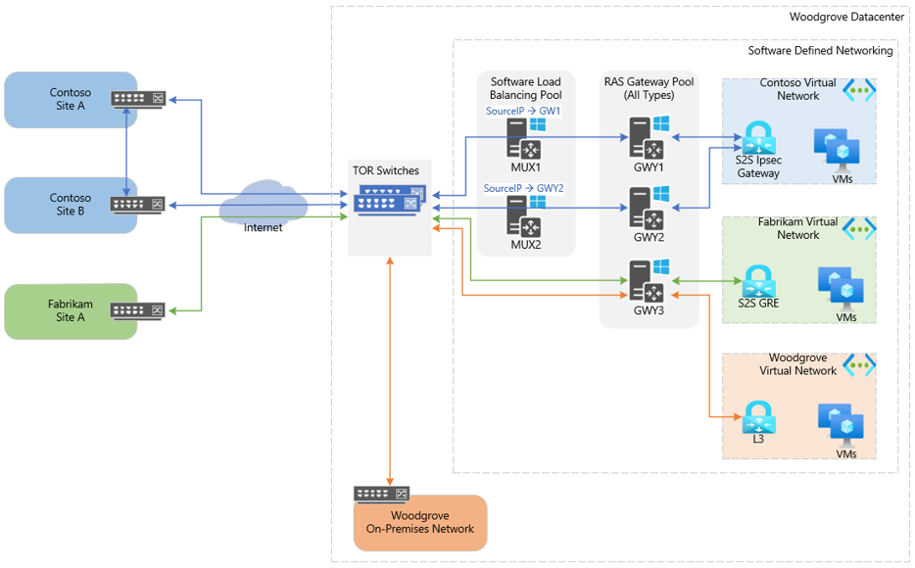
RAS Gateway deployment
Notes:
In the diagram above, there are three separate tenants that have deployed resources within respective virtual networks.
Contoso has opted to create a S2S IPsec Gateway to connect their virtual network in the CSP datacenter to their on-premises locations.
A Gateway subnet is allocated from within the Contoso Virtual Network and Virtual Network Gateway using IPsec is created. They have created multiple connections within their Virtual Network Gateway to each of their on-premises locations. A public VIP is associated with the S2S connections in which the SLB is configured to redirect the VIP to the appropriate GWY VM that is hosting the S2S connection. GWY VM will then process the IPsec payload and route across the provider network to deliver the packet the respective customer address.
Fabrikam tenant has opted to leverage a S2S GRE tunnel. Tenant, CSP and internet service provider (ISP) have established a high speed MPLS tunnel between the Tenant network and Woodgrove datacenter. BGP Peering allows routes to be automatically shared between their site and virtual network hosted in the Woodgrove datacenter. Routes are automatically configured within the dataplane, to enable direct routing using the private IP address of resources deployed within the virtual network.
Woodgrove has also decided to virtualize some of their workloads and leverage the environment as an IaaS platform. To bridge connectivity between their existing on-premises network and virtual network, they have opted to create a L3 Gateway and configure the appropriate TORs and switches within their physical network to enable the routing between networks.

Slide 28
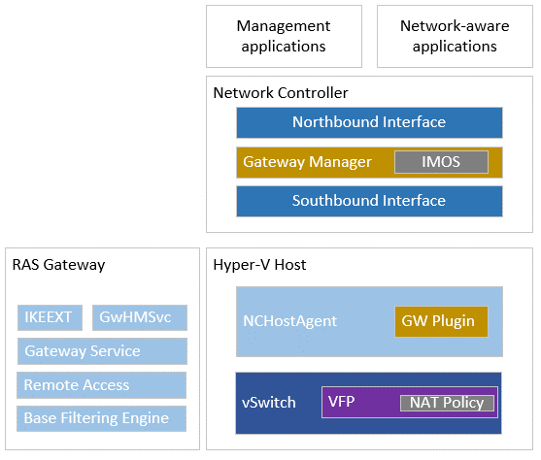
Architecture overview
Gateway architecture is composed of the following resources:
Gateway Manager Service
RAS Gateway
Gateway Health Monitoring Service
Gateway Service
Remote Access
Base Filtering Engine
IKEEXT
NC Host Agent
Gateway Plugin
Virtual Filtering Platform (VFP)

Slide 29
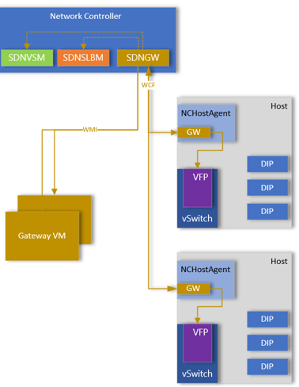
Policy configuration
SDN GWM (SDNGWM) will receive REST operations via Northbound API.
GWM will communicate with VNET and vSwitch Manager (VSM) and SLB Manager.
Gateway Manager pushes configuration to RAS Gateways using WMI.
Gateway Manager configures Gateway Plugin within NCHostAgent using WCF.
Gateway Plugin configures VFP policies directly (does not leverage OVSDB).
Notes:
Gateway Plugin is only used for FastPath scenarios. If not using FastPath tunnels, GWM will coordinate with the VNET component of SDNVSM to update the routing configuration. SDNVSM will then use its policy configuration routing method to push the route configuration into the dataplane.

Slide 30
Azure Local SDN Requirements
here are several hardware and software prerequisites for an SDN infrastructure, including:
Physical network. You need access to your physical network devices to configure virtual local area networks (VLANs), routing, and the Border Gateway Protocol (BGP). This topic provides instructions for manual switch configuration, and options to use either BGP peering on Layer-3 switches / routers, or a Routing and Remote Access Server (RRAS) virtual machine (VM).
Physical compute hosts. These hosts run Hyper-V and are required to host an SDN infrastructure and tenant VMs. Specific network hardware is required in these hosts for best performance, as described in the next section.
Dynamic DNS registration. This step is optional if Network Controller is deployed on host machines. For deployment on VMs, you must prepare your datacenter and optionally configure dynamic DNS registration.

Slide 31
Switch Requirements
Switchport MTU settings (required)
MTU set to >= 1674 bytes (including L2-Ethernet Header)
L3 protocols (required)
Equal-cost multi-path (ECMP) routing
BGP (IETF RFC 4271)-based ECMP
Implementations should support the MUST statements in the following IETF standards:
RFC 2545: BGP-4 Multiprotocol extensions for IPv6 Inter-Domain Routing
RFC 4760: Multiprotocol Extensions for BGP-4
RFC 4893: BGP Support for Four-octet AS Number Space
RFC 4456: BGP Route Reflection: An Alternative to Full Mesh Internal BGP (IBGP)
RFC 4724: Graceful Restart Mechanism for BGP
The following tagging protocols are required:
VLAN - Isolation of various types of traffic
802.1q trunk
The following items provide Link control:
Quality of Service (QoS) (PFC only required if using RoCE)
Enhanced Traffic Selection (802.1Qaz)
Priority-based Flow Control (PFC) (802.1p/Q and 802.1Qbb)
For testing/lab purposes I personally recommend Mikrotik Router (BGP Support is there since RouterOS version 7.x)

Slide 32

Lessons Learned
The physical requirements are essential
For 2026 onwards this will be the default setting in Azure Local
Start now to understand – better than wait for once it’s there and you have a first customer project. ☺
Notes:
Die Lektionen aus vergangenen Projekten sind wichtig für zukünftige Implementierungen. Eine gründliche Planung, regelmäßige Schulungen und das Einholen von Nutzerfeedback sind wesentliche Faktoren für den langfristigen Erfolg von SDN-Lösungen.

Slide 33
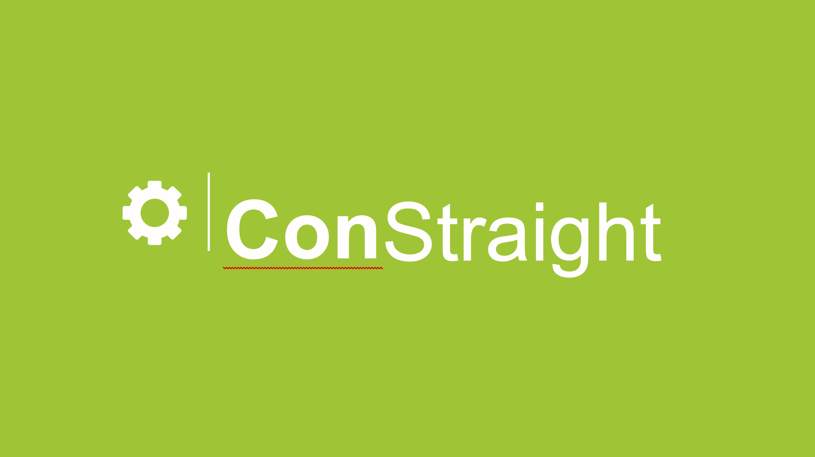
ConStraight
Westfalenring 27, D-48712 Gescher
📞 + 49 2542 9299407
http://www.constraight.com
info@constraight.com

Slide 34











Danke an unsere Sponsoren
PLATINUM
GOLD

Slide 35
Closing

